Slide 1
Advanced Data Processing In R
Nichola Burton

Slide 2
Today:
Why process your data in R?
A basic philosophy of data management
Reading and writing data files in R
For-loops
Worked example

Slide 3
Some basic tips for enjoyable coding (from an untrained amateur)
Don’t sell yourself short
Give yourself time (and permission) to make mistakes when you’re learning
Expect and accept debugging as part of the process
Start small and work up
Use good version control and make lots of notes
Ask for help
Try to understand the code you’ve been given

Slide 4
Why R?
Excel and SPSS do the job…
R is flexible
Provides clean, reproducible data processing and analysis flows
Used in government and industry
Coding: a bonus transferable skill
and free

Slide 5
How transferable?

Slide 6
Data Management: My Philosophy
Assume you will have to re-run your analyses at least once
Assume that you will have to come back to these data in five years’ time
Be prepared for a reviewer to ask to see your data and scripts…(!!!)

Slide 7
Data Management: My Philosophy
Avoid having duplicate data in multiple locations
Avoid running processes manually
Keep records of all of your decisions at each step

Slide 8
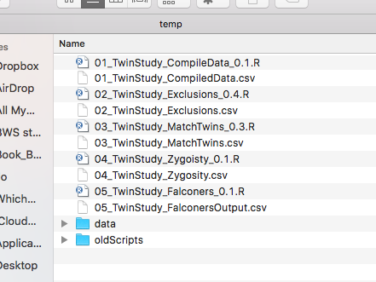
Data Management: My Philosophy
In a perfect world, from raw data to analysis via neatly-annotated, step-by-step scripts.

Slide 9
Today’s data processing problem:
You have lots of individual participants’ data, all in separate files
You want a single spreadsheet with all the data together, ready for analysis
You’re sick of doing this by hand!

Slide 10
Structure of the solution:
Work out what you need to extract out of each data file
One row per participant? What’s in the row?
Work out how to get this out of one file
List all of your data files
Run the process on each file in turn
Put together the extracted values
Save the compiled data

Slide 11
What do we want from our files?

Slide 12
Some tips
Always get to know your raw data first!
Check your scripts!
Make sure the output makes sense
Go through at least one data file step-by-step and make sure you’re getting the expected results
Check your logic with a friend!

Slide 13
Some Exercises:
At the end of our data files we asked two more questions: can you add the responses to our compiled data sheet?
Now that we have our compiled data, can you make a new script which opens the file we just made, finds the mean rating for each target face and saves this information out in a new file?

Slide 14
More resources:

